Slide 1
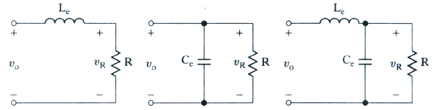
Rectifier circuit design
Determination of the rating of semiconductor diodes
average current, rms current, peak current and peak inverse voltage
Design of filters at the output (dc side) to remove voltage harmonics. These filters are called dc filters.
They are L, C and LC type
DC FILTERS
v_{d}
v_{d}
v_{d}
Design of filters at the input (ac side) to remove current harmonics. These filters are called ac filters and are usually of LC type.

Slide 2
DC FILTERS
To design a dc filter circuit, knowledge of the magnitude and frequency of harmonics at the dc side is required.
Output voltage is

Slide 3
Output voltage of the full wave rectifier contains only even harmonics.
Second harmonic at 100Hz is the most dominant harmonic.

Slide 4
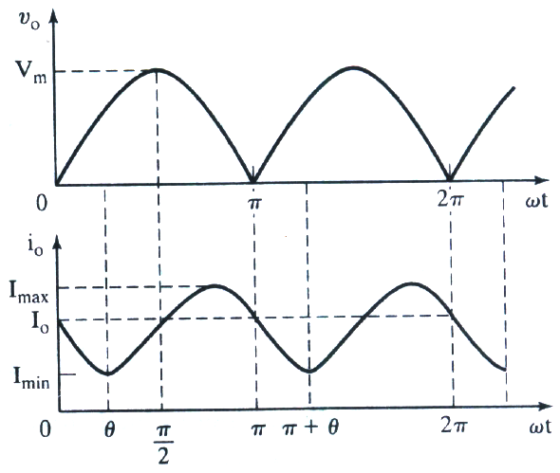
L filter to reduce ripple in output current
A single phase bridge rectifier is supplied from a 220V,50Hz source. Load resistance is 500 Ω. Calculate the value of series inductor L that limits the rms ripple current to be less than 5%of I_{dc}
v_{d}
v_{d}

Slide 5
DC value of output current
RMS value of ripple current I_{ac}
Neglecting all harmonics other than predominant second harmonic

Slide 6
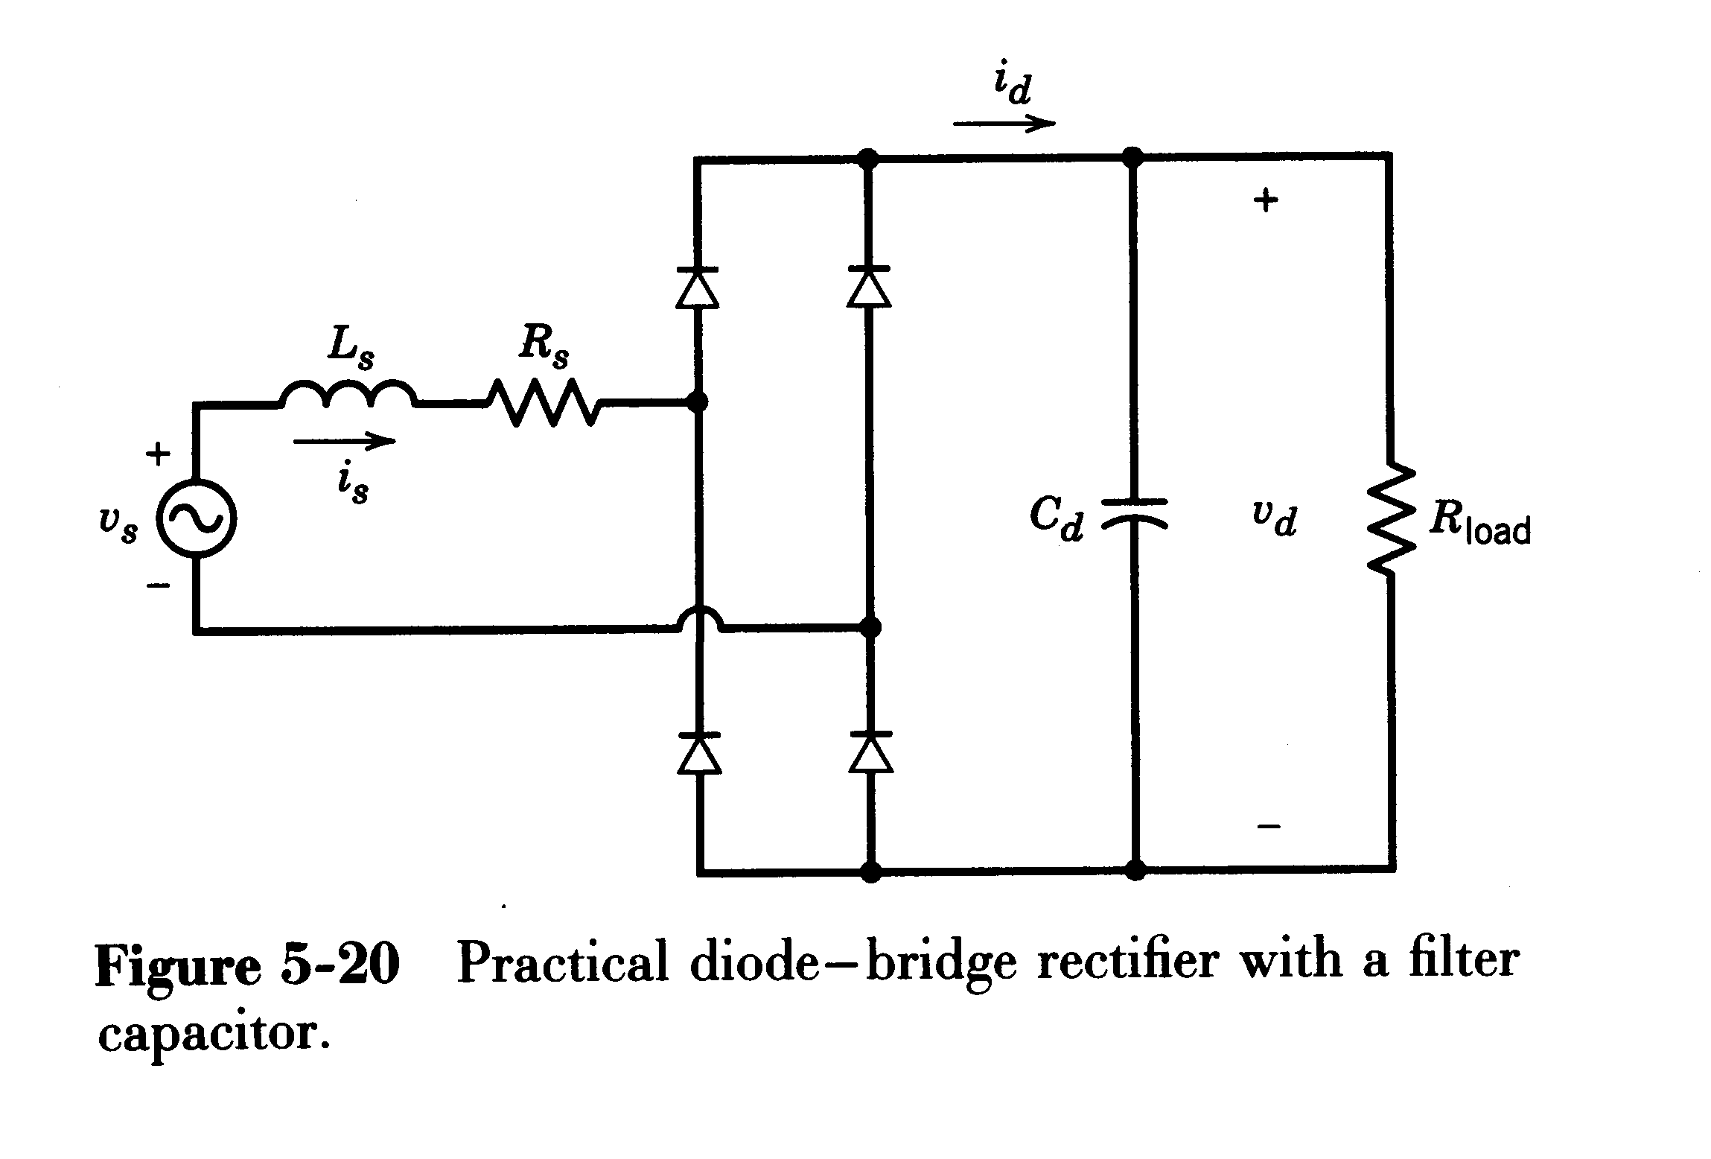
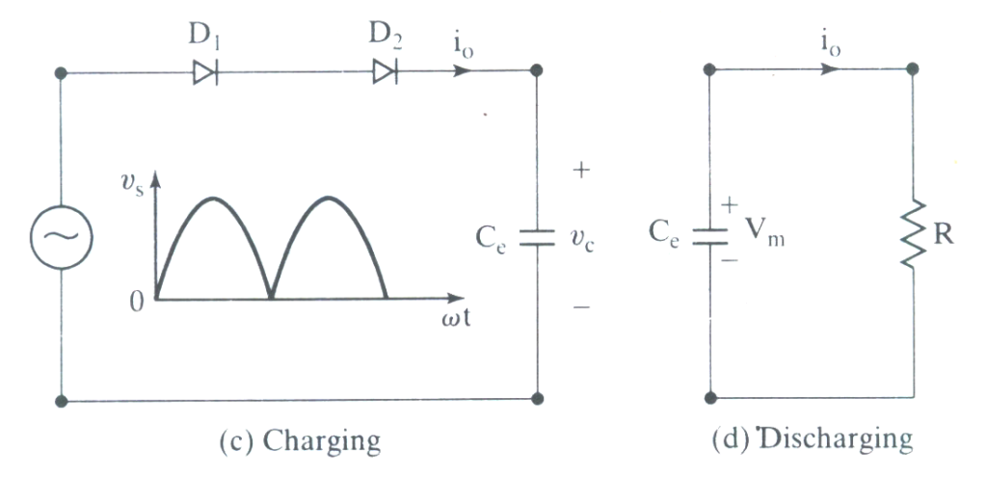
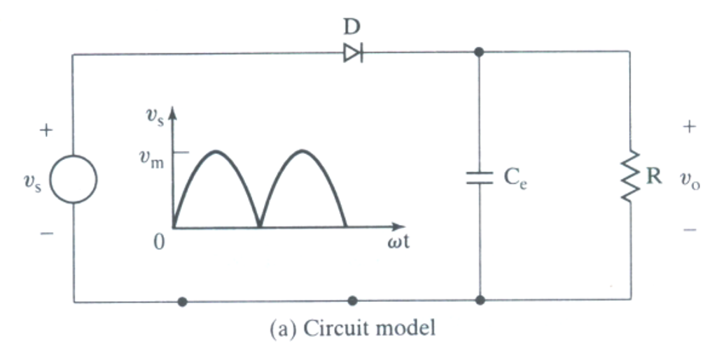
Diode Bridge rectifier with a Capacitor Filter to limit the amount of output voltage ripple
C_{d}
C_{d}
C_{d}
v_{d}
v_{d}

Slide 7
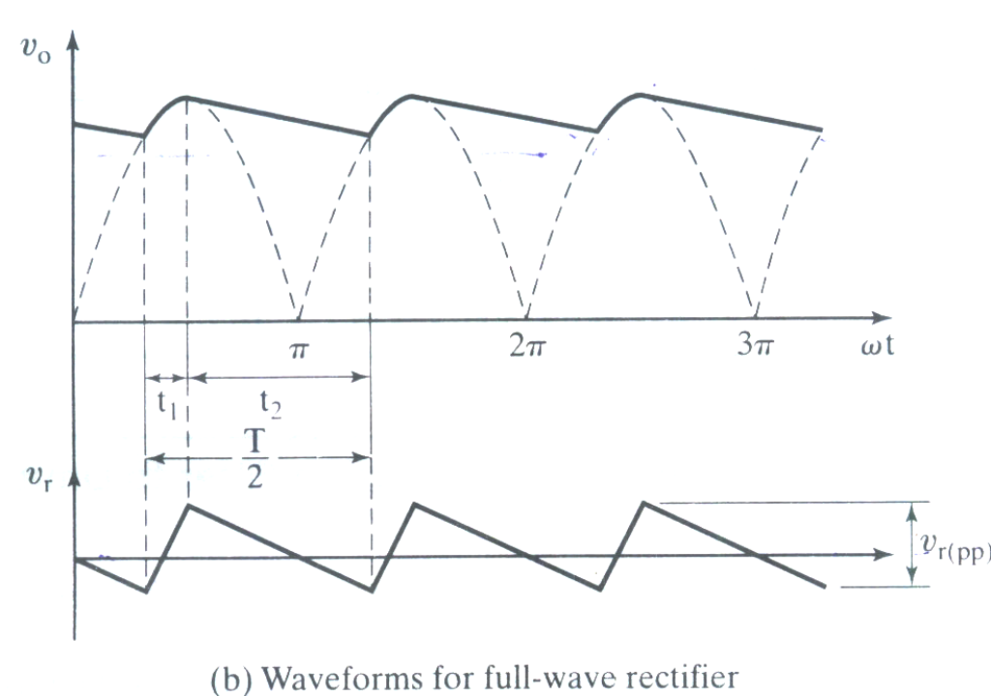
0→A
v_{s} < v_{d.} All diodes are off.
Capacitor discharges to load R.
load current i₀ = v_{c}/R v_{d} = v_{c}
v_{d}
A
Π+A
v_{ripple}
π/2 → π + A v_{s} < V_{c ,}
All diodes are off. (during t₂)
Capacitor discharges to load R.
v_{d} = v_{c} i_{d} = v_{c}/R
π + A → 3π/2 -v_{s} < V_{c ,}
diodes D₃ and D₄ conduct.
Capacitor gets charged to v_{m}
v_{d} = v_{c} = - v_{s} i_{d} = v_{c}/R
A → π/2 v_{s} > V_{c ,}
diodes D₁ and D₂ conduct. (during t₁)
v_{d} = v_{c} = v_{s}
Capacitor gets charged to v_{m}

Slide 8
During discharging period t₂
Capacitor voltage during t₂
Maximum capacitor / load voltage is V_{m}
Minimum capacitor / load voltage v_{dminimum} is
Peak to peak ripple voltage
v_{d}
A
Π+A
v_{ripple}

Slide 9
RMS value of ripple voltage V_{ac} =
Average load voltage =
v_{d}
A
Π+A
v_{ripple}

Slide 10
Ripple factor of output voltage RF =
C_{e} is selected such that RF is within the permissible limit.

Slide 11
A single phase bridge rectifier supplied from a 220V, 50Hz source. The load resistance is R=500ohms. Design a C filter so that the ripple factor of the output voltage is less than 5%.

Slide 12
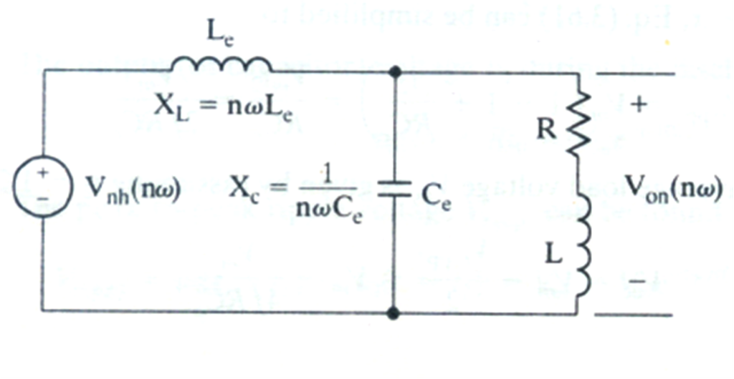
LC filter to limit the output ripple
Rectifier output
V_{dn}(ωt)
V_{0n}
Equivalent circuit with LC filter and R-L load

Slide 13
For n^{th} harmonic to pass through the capacitor,
the capacitance impedance must be much smaller than
that of the capacitor
This condition is satisfied
when, for the most predominant second harmonic,
load impedance must be very large compared to C_{e} .
For n^{th} harmonic current, load behaves as open circuit.
The RMS value of nth harmonic component of voltage across the C_{e}
V_{dn}(ωt)
V₀(nω)
C_{e} is selected such that this condition is satisfied.
V_{0n}
V_{dn}
V_{dn}

Slide 14
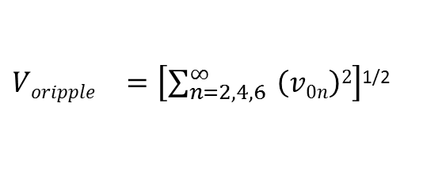
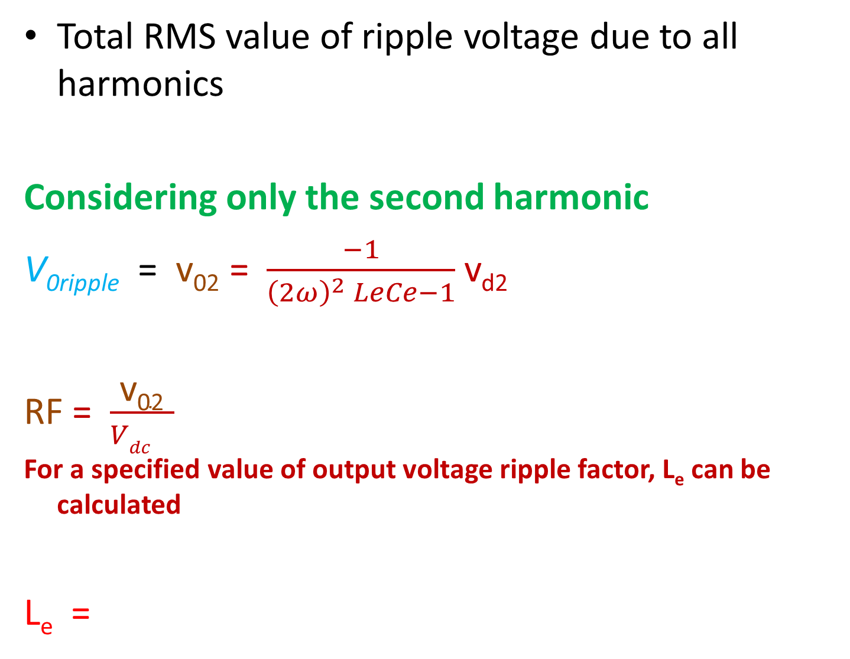
Total RMS value of ripple voltage due to all harmonics
Considering only the second harmonic
V_{0ripple} = v₀₂ = $\frac{−1}{{\left(2ω\right)}^{2} LeCe−1}$ v_{d2}
RF = $\frac{\text{v}\text{02}}{{Vdc}^{} }$
For a specified value of output voltage ripple factor, L_{e} can be calculated
L_{e} =
${Voripple}^{}=\left[\sum_{n=2,4,6}^{∞}{ \left(v0n\right)2}\right]$^{1/2}
V_{d2}

Slide 15
An LC filter is used to reduce the amount of ripple content at the output of a single phase full wave rectifier ,the load resistance R=40Ω,load inductance L=10mH,and source is 220V, 50Hz. Design an LC filter so that RF of the output is 10%.

Slide 16
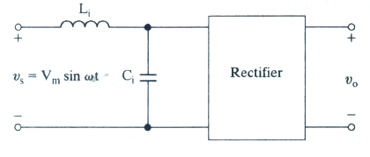
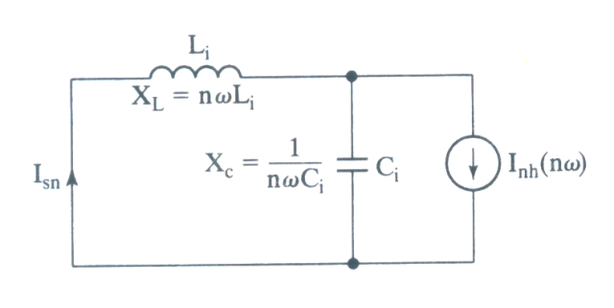
Input LC filter to limit the amount of input ripple current
i_{s}
→
i_{s} ‘
→
I_{d}
I_{sn} is the n^{th} harmonic current in the source.
I_{sn}’
I_{sn}’ is the n^{th} harmonic current at the input of rectifier.
Equivalent circuit for nth harmonic current

Slide 17
by the current divider rule
The total harmonic current in the ac supply line is
Harmonic factor of input current when LC filter is used
Considering only the dominant third harmonic,
I_{sn},

Slide 18
For a specified value of Harmonic factor of input current r,
L_{i} C_{i} can be calculated.
Choose a convenient value for C_{i} and then obtain the value of L_{i}
Filter resonant frequency

Slide 19
An LC filter is to be designed to limit the amount of ripple in input current for a single phase full wave rectifier. The load current is ripple free. Supply frequency is 50Hz. Determine the resonant frequency of the filter so that total harmonic current is reduced to 1% of fundamental

Slide 20
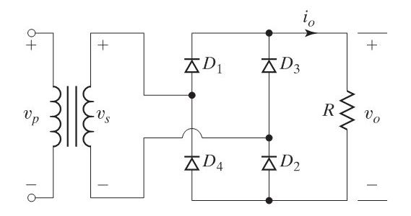
The single-phase bridge rectifier of Figure P1.4 is required to supply an average voltage of V_{dc} = 400 V to a resistive load of R =10Ω.Determine the voltage and current ratings of diodes and transformer.

Slide 21
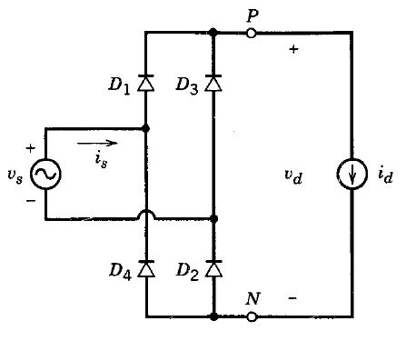
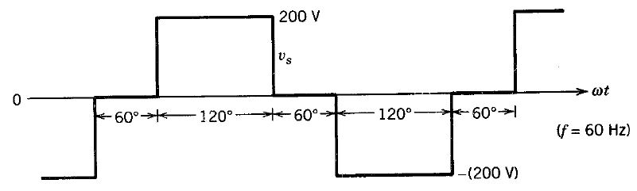
In the single-phase diode rectifier circuit shown in Fig. below with zero L_{s} and a constant dc current I_{d} = 10 A, calculate the average power supplied to the load:
If V_{s} is a sinusoidal voltage with V_{s} = 120 V at 60 Hz
If V_{s} has the pulse waveform shown in Fig. below

Slide 22
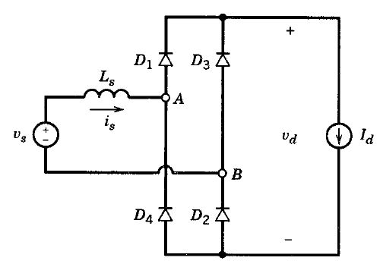
In the single phase rectifier circuit shown in Fig. below, V_{s} = 120 V at 60 Hz, Ls = 1 mH, and I_{d} = 10 A. Calculate overlap period u, V_{d}, and P_{d}. What is the percentage voltage drop in V_{d} due to L_{s}?
Repeat above Problem
if V_{s} has a 60 Hz square waveform with an amplitude of 200V
If V_{s} has the pulse waveform shown in Fig. below

Slide 23
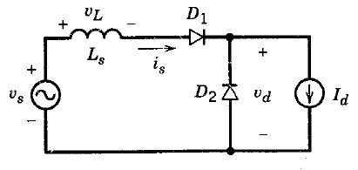
Consider the basic commutation circuit of Fig. below with I_{d} = 10 A.
With V_{s} = 120 V at 60 Hz and L_{s} = 0, calculate V_{d} and the average power P_{d}.
With V_{s} = 120 V at 60 Hz and L_{s} = 5 mH, calculate u, V_{d}, and P_{d}.
Here V_{s} has a 60 Hz square waveform with an amplitude of 200 V, and L_{s} = 5 mH. Plot the i_{s} waveform and calculate u, V_{d}, and P_{d}.
Repeat part (c) if V_{s} has the pulse waveform shown in Fig. below

Slide 24
3Ф Uncontrolled Rectifier
Low ripple content
Higher power handling capability

Slide 25
3Ф Half Wave Uncontrolled Rectifier circuit
i_{a}
i_{b}
→
i_{c}
→

Slide 26
A B V_{AO} is most positive
D₁ is on
V_{d} = V_{AO}
B C V_{BO} is most positive
D₂ is on
V_{d} = V_{BO}
C A V_{CO} is most positive
D₃ is on
V_{d} = V_{CO}

Slide 27
Average load voltage
V_{s} is the RMS per phase voltage of supply.
RMS value of voltage across the load
Load voltage form factor =
Ripple factor = γ =

Slide 28
Ripple Frequency = 3 times supply frequency
PIV of diode =
As the load is resistive,
Average load current = I_{davg} = V_{davg}/R_{L}
RMS load Current = I_{dRMS} = 1.01 I_{davg}
Total load Power = P = I_{dRMS}² R_{L}
Let I_{D} is the RMS value of current through a diode.
3I_{D}² R_{L =} I_{dRMS}² R_{L}
I_{D} =
Each diode must carry an RMS value of current equal to 58% of average load current

Slide 29
If the rated transformer secondary RMS current is chosen same as that of diode RMS current.
Transformer secondary VOLTAMPERE = 3V_{s}I_{D}
=1.5V_{davg}I_{davg}
=1.5× dc load power

Slide 30
3Ф Fullwave Diode bridge rectifier circuit
Interval | Devices conducting | V_{d} | i_{a} | i_{b} | i_{c}
i_{a}
→
i_{b}
0
→
A→B
D₆, D₁
V_{ab}
+I_{d}
-I_{d}
i_{c}
→
V_{ac}
+I_{d}
0
-I_{d}
L_{s}
B→C
D₁, D₂
V_{bc}
0
+I_{d}
-I_{d}
C→D
D₂, D₃
Assumptions
L_{s} = 0
-I_{d}
0
i_{d} = is constant at I_{d}
D→E
D₃, D₄
V_{ba}
+I_{d}
E→F
D₄, D₅
V_{ca}
-I_{d}
0
+I_{d}
F→A
D₅, D₆
V_{cb}
0
-I_{d}
+I_{d}

Slide 31
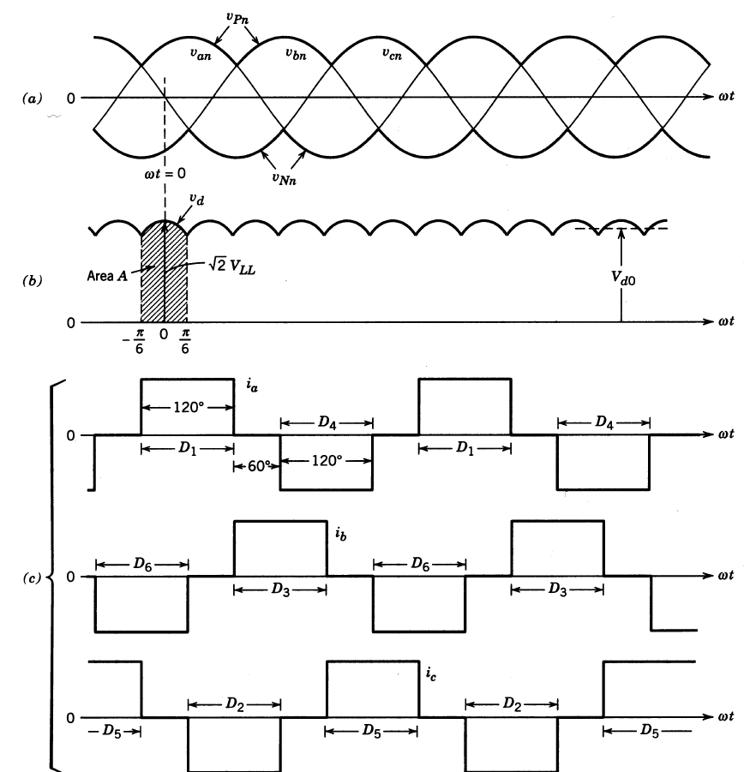
Waveforms

Slide 32

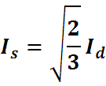
Performance parameters
Average load voltage
V_{LL} is the RMS value of line to line voltage
RMS value of line current is
I_{a}

Slide 33
Instantaneous value of fundamental component of i_{a}
i_{a1} = a₁cosωt + b₁sinωt
RMS value of fundamental component of source line current

Slide 34
RMS value of h^{th} harmonic components of line current i_{ah}
I_{ah} = I_{a1} / h, h = 5, 7, 11, 13, etc
Even and triplen harmonics are absent.
source side apparent power =
source side active power =
source side power factor =

Slide 35
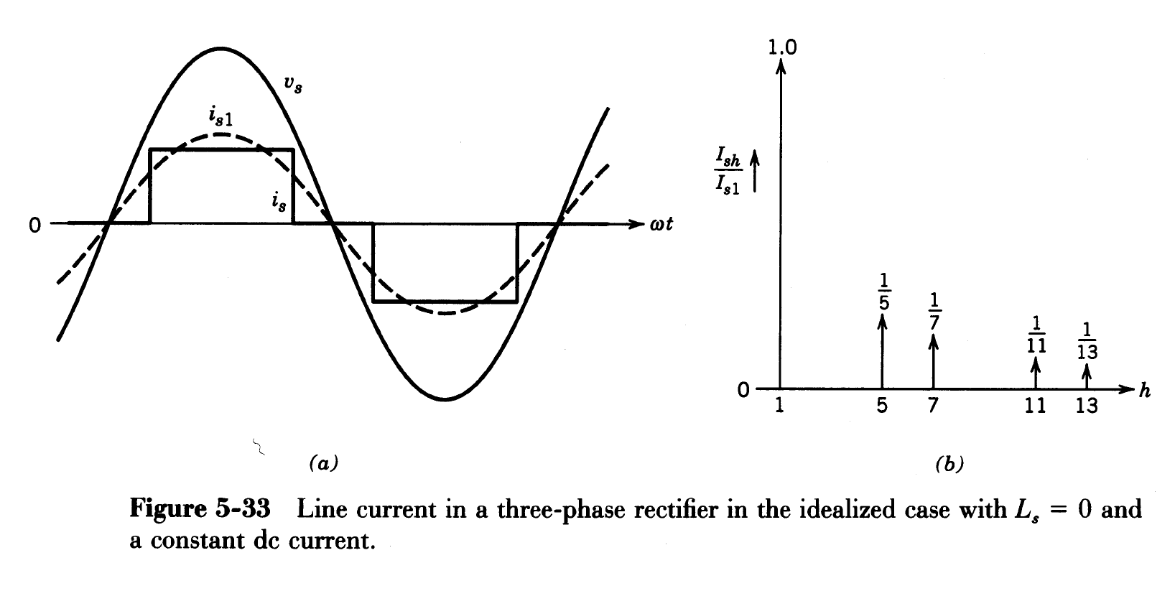
Harmonic spectrum
v_{an}
i_{a1}
Harmonic spectrum
i_{a}

Slide 36
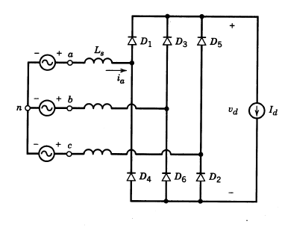
Effect of source inductance
Output current is assumed to be constant
Due to source inductance current commutation is not instantaneous
For ωt < ∏/6 , D₅ and D₆ were conducting.
For ω > ∏/6 , V_{an} is greater than V_{cn}
D₁ starts conducting. Due to L_{s} i_{a} rises from zero to I_{d} through D₁ gradually in a period µ ie during ∏/6 to ∏/6 + µ
During the same interval, i_{c} decreases from I_{d} to zero through D₅
During ∏/6 to ∏/6 + µ, D_{5,} D₆ and D₁ conduct.

Slide 37
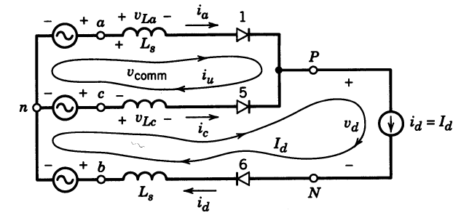
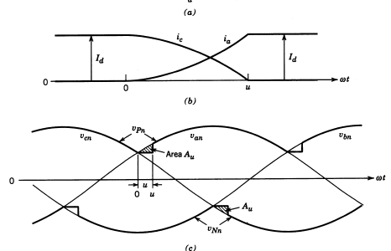
Output current is assumed to be constant
Due to source inductance current commutation is not instantaneous
At ∏/6 , i_{c} decreases from I_{d} to zero and i_{a} rises from zero to I_{d} in a period µ
∏/6 → ∏/6+ µ
i_{b} = -I_{d}
Equivalent circuit during µ

Slide 38
i_{b} = -I_{d}
during µ
Equivalent circuit during µ
Average output voltage=

Slide 39
Overlap angle µ
Equivalent circuit during µ

